Slide 1

University of Chittagong
Decision Making Statement
Dr. Abu Nowshed Chy
Department of Computer Science and Engineering
Faculty Profile

Slide 2
Decision Making Statements
Decision Making Statements:
Decision making is about deciding the order of execution of statements based on certain conditions or repeat a group of statements until certain specified conditions are met.
Decision Making Statements in Java:
If Statement
If…Else Statement
The Else If Ladder
2

Slide 3
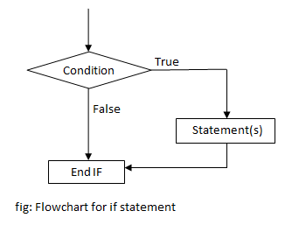
“if” Statement
if (test expression)
{
// statements to be executed
if the test expression is true;
}
Test expression
General Form
Flow Chart
3

Slide 4
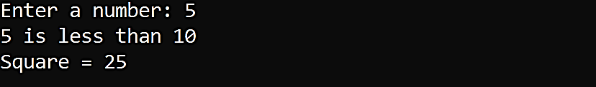

Square of a Number Less Than 10
Program:
Write a program to print the square of a number if it is less than 10.
Output:
4

Slide 5
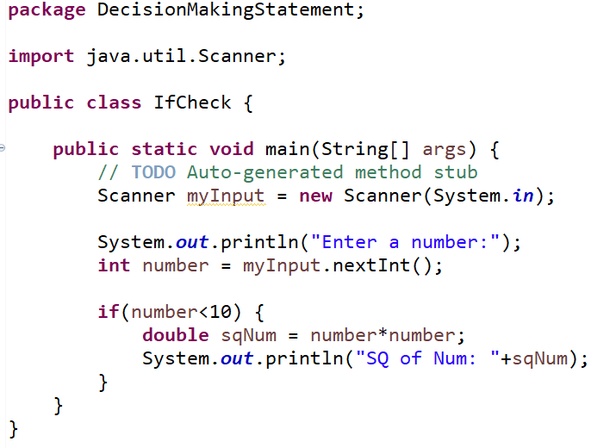
Square of a Number Less Than 10
Program:
5

Slide 6
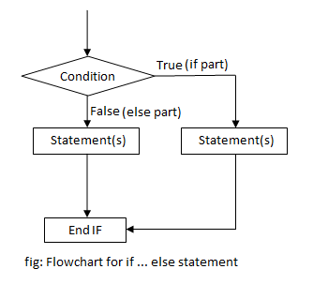
“If…Else” Statement
if(test expression)
{
// true statements;
}
else
{
// false statements;
}
Test expression
General Form
Flow Chart
6

Slide 7
Square of a Number Less Than 10
Program:
Write a program to print the square of a number if it is less than 10, otherwise print a message.
Output:
7

Slide 8
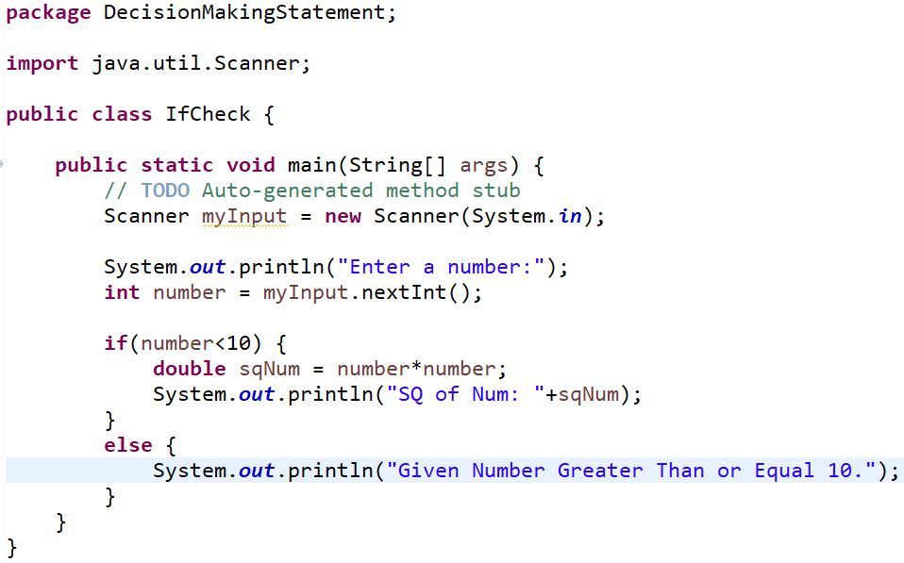
Square of a Number Less Than 10
Program:
8

Slide 9
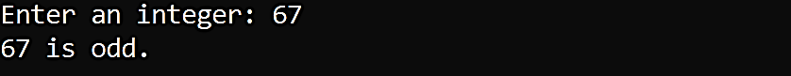
Even Odd Check
Program:
Write a program to check whether a number is even or odd.
Output:
9

Slide 10
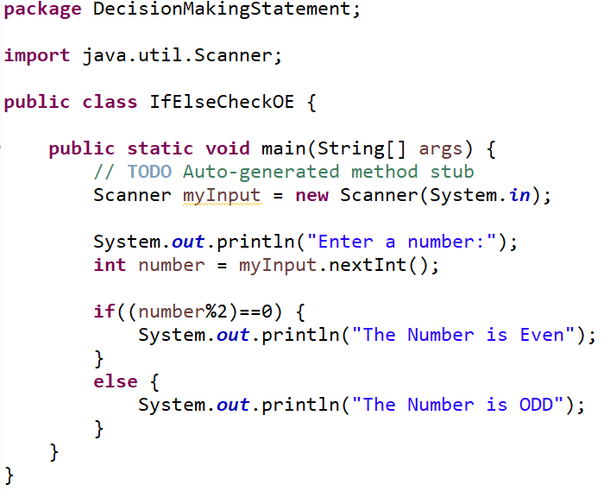
Even Odd Check
Program:
10

Slide 11

Character Related Equality Check
Program:
Write a program to check whether a given character is vowel or consonant.
Output:
Enter a Character:
a
Vowel
11

Slide 12
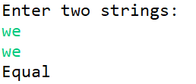
String Related Equality Check
Program:
Write a program to check whether two given strings are equal or not.
Output:
12

Slide 13
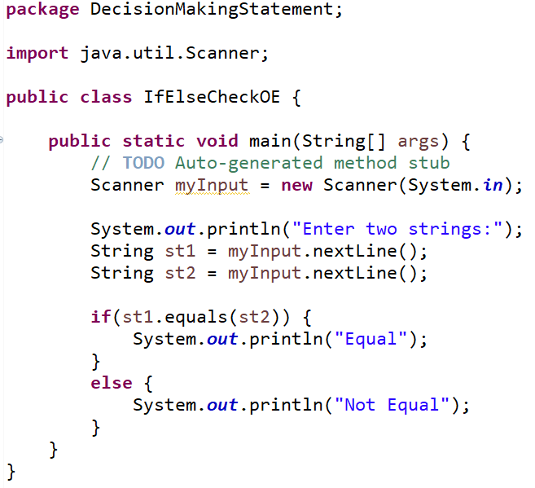
String Related Equality Check
Program:
13

Slide 14
Uppercase and Lowercase Conversion
Uppercase means capital letter
Lowercase means small letter
We want to write a program that will change the case of a given String.
Uppercase will become lower case.
And lowercase will become upper case.
14

Slide 15
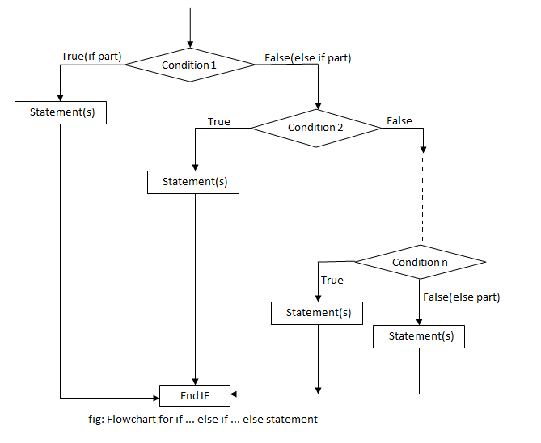
“The Else If Ladder”
if(condition 1)
{
// statement 1;
}
else if (condition 2)
{
// statement 2;
}
else if (condition n)
{
// statement n;
}
else
{
// default statement;
}
General Form
Flow Chart
15

Slide 16
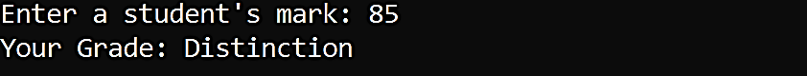
Grading Using the Else If Ladder
Program:
Write a program to print grade of a student using the else if ladder.
Marks Grade
80 to 100 Distinction
70 to 79 Very Good
60 to 69 Pass
Below 60 Fail
Output:
16

Slide 17
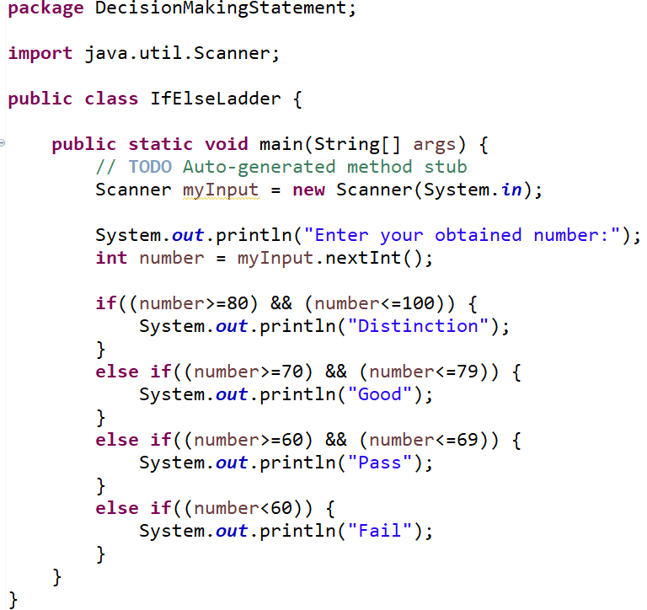
Grading Using the Else If Ladder
Program:
17

Slide 18
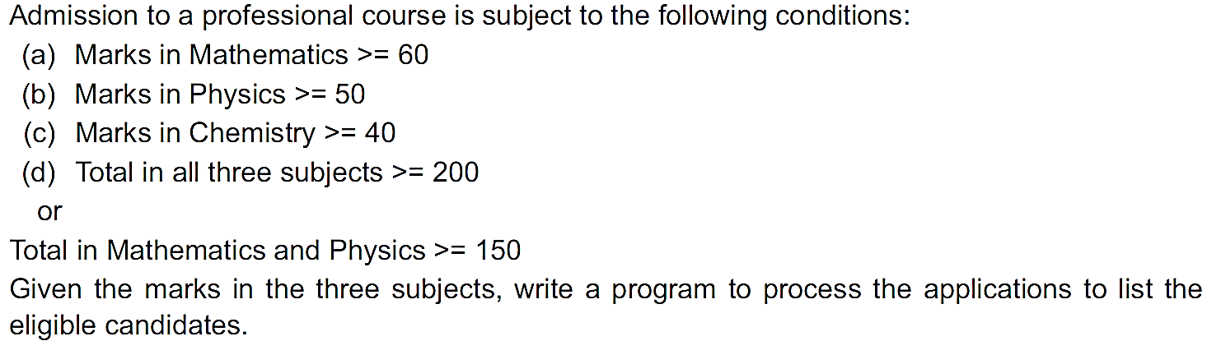
Practice Program# 1
18

Slide 19
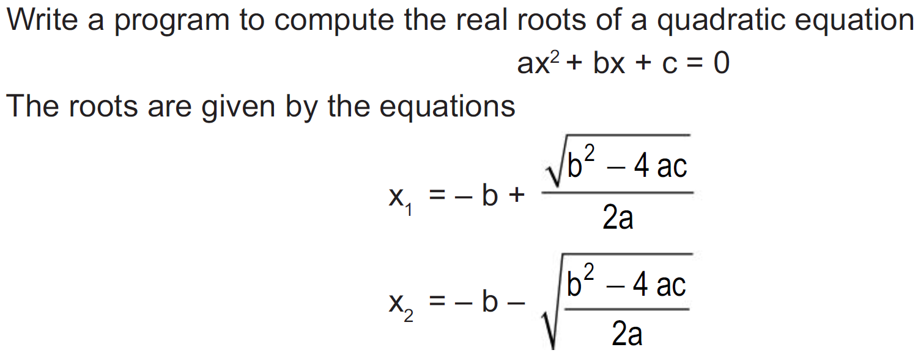
Practice Program# 2
19

Slide 20
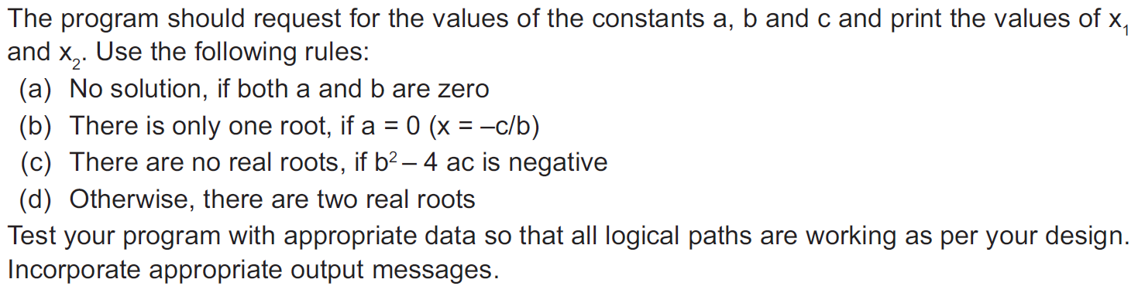
Practice Program# 2
20

Slide 21
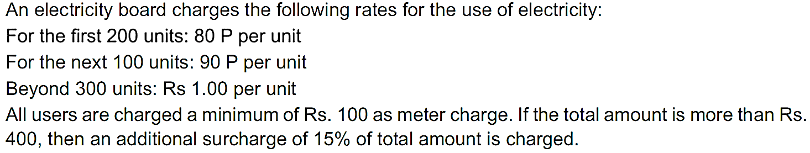
Practice Program# 3
Write a program to read the number of units consumed and print out the estimated charges.
21

Slide 22

22

